Slide 1
Time-based Anomaly Detection using Autoencoder
†David R. Cheriton School of Computer Science
‡Ericsson Security Research
Mohammad A. Salahuddin†, Md. Faizul Bari†, Hyame Assem Alameddine†,‡,
Vahid Pourahmadi†, and Raouf Boutaba†

Slide 2
Outline
Motivation & Contributions
System Overview
  Components
  Time-based Feature extractor
  Anomaly Detector
    Autoencoder
    Reconstruction Error
    Threshold Selection
Dataset & Evaluation Metrics
Experiments
  Anomaly Detection using Flow-based Features
  Anomaly Detection using Time-based Features
Future Directions

Slide 3
MOTIVATION & CONTRIBUTIONS

Slide 4
Motivation
Increased reliance on telecommunication networks
Increased risk of cyber threats
  Recent surge in cyber attacks, primarily DDoS attacks
  Significant loss of revenue
DDoS attacks
  Deplete network resources
  Prevent legitimate network access
  Remain a serious threat
Machine learning still being employed with flow-based statistical features
  Not discriminative enough to detect various DDoS attacks, especially zero-day and polymorphic attacks

Slide 5
Contributions
A novel time-based anomaly detection system using an Autoencoder
Highlight limitations of typical flow-based features
Study the impact of time-windows on detecting anomalous DDoS traffic
Showcase robustness of our system to zero-day attacks
Evaluations performed on a recent publicly available dataset

Slide 6
SYSTEM OVERVIEW

Slide 7
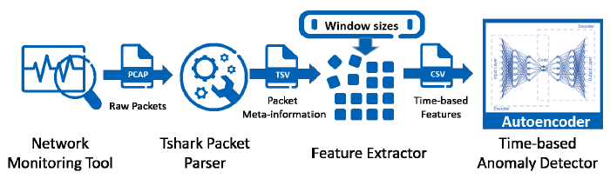
Components
Network monitor
TShark packet parser
Feature extractor
Anomaly detector
w=10ms, w=10sec,
or w=10ms,10sec
Detect
Anomalous
time windows

Slide 8
Feature Extractor*
Sample features, statistics of
  Bandwidth of outbound traffic
  Bandwidth of outbound and inbound traffic together
  Packet rate of outbound traffic
  Inter-packet delays of outbound traffic
t
t+w
Packet Stream
P
w=10sec
Time
Windows
w=1sec
w=10ms
Dst IP
Src MAC
Dst Socket
Src IP
Src IP
Src IP
Src Socket
Aggregation levels
* Y. Mirsky et al., “Kitsune: An Ensemble of Autoencoders for Online Network Intrusion Detection,” NDSS, 5(2), February, 2018.

Slide 9
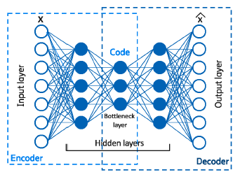

Anomaly Detector
Autoencoder
Reconstruction error

Slide 10
Anomaly Detector
Threshold selection
  Create an optimization dataset
  Generate reconstruction errors for benign data
  Sort benign reconstruction errors in descending order
  Iterate over the highest thresholds based on pre-determined steps and depth
    Predict reconstruction errors for the optimization dataset and compute F1-score
  Select threshold that results in the highest F1-score as the optimal threshold for the Autoencoder

Slide 11
DATASET & METRICS

Slide 12
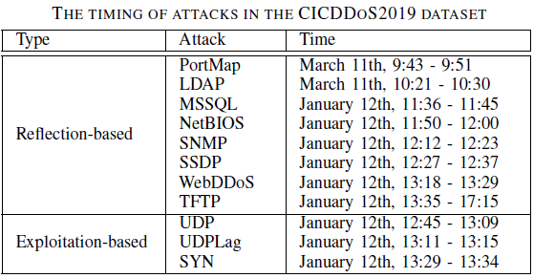
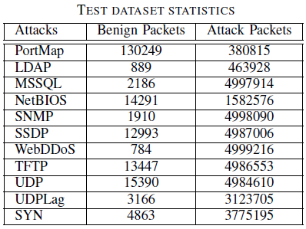
CICDDoS2019 Dataset*
* I. Sharafaldin et al., “Developing realistic distributed denial of service (DDoS) attack dataset and taxonomy,” IEEE ICCST, October, 2019.

Slide 13



Evaluation Metrics
Harmonic mean
of
Precision and Recall

Slide 14
EXPERIMENTS

Slide 15


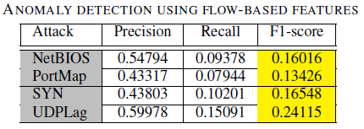
Flow-based Anomaly Detection
Pipeline
Baseline results
Autoencoder
PCAP
CICFlowMeter
Generate
Ingest
Detect
Anomalous
flows
Flow-level statistics

Slide 16
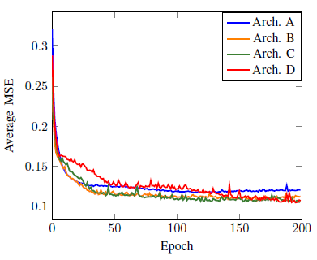

Time-based Anomaly Detection
Autoencoder selection
  Arch. A = [k; k×30%; k]
  Arch. B = [k; k×70%; k×30%; k×70%; k]
  Arch. C = [k; k×80%; k×50%; k×30%; k×50%; k×80%; k],
  Arch. D = [k; k×80%; k×60%; k×40%; k×30%; k×40%; k×60%; k×80%; k]

Slide 17
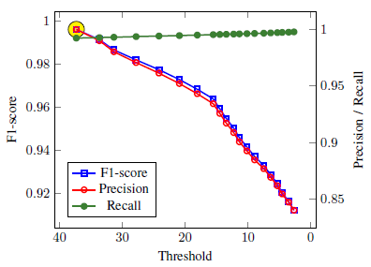
Time-based Anomaly Detection
Threshold selection

Slide 18
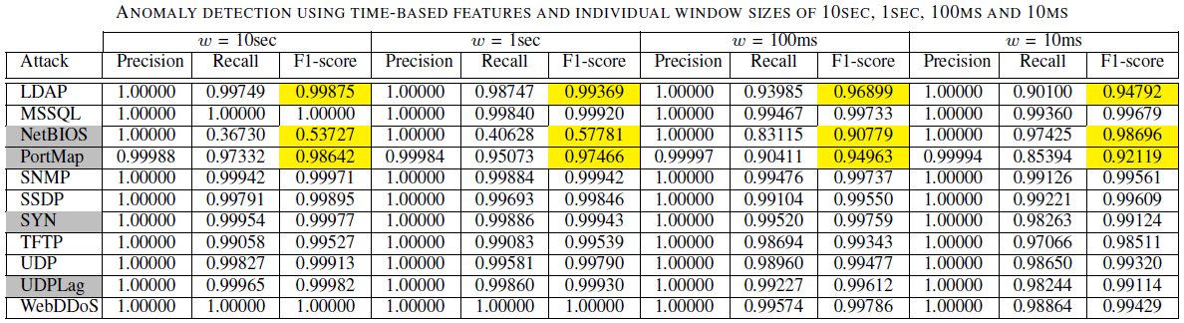
Time-based Anomaly Detection
Impact of individual window sizes

Slide 19
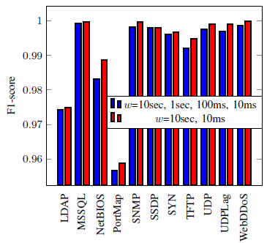
Time-based Anomaly Detection
Impact of aggregated window sizes

Slide 20
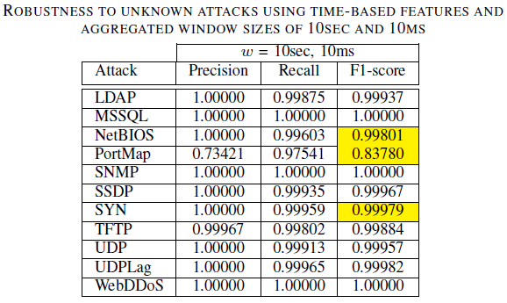
Time-based Anomaly Detection
Robustness to zero-day attacks

Slide 21
FUTURE DIRECTIONS

Slide 22
Future Directions
Evaluate Autoencoder performance on contaminated training data
Explore threshold selection techniques that are independent of labeling
Explore relationship between window sizes and attack characteristics
Compare with other state-of-the-art approaches

Slide 23
THANK YOU!

