Slide 1
AI-driven Closed-loop Automation in 5G and beyond Mobile Networks
ACM FlexNets
August 23, 2021
Raouf Boutaba, Nashid Shahriar, Mohammad A. Salahuddin, Shihabur R. Chowdhury, Niloy Saha, Alexander James
Notes:
We’ll present our vision for closed-loop service orchestration and network management of 5G and beyond mobile networks. We also discuss some of the open challenges in realizing this vision.

Slide 2
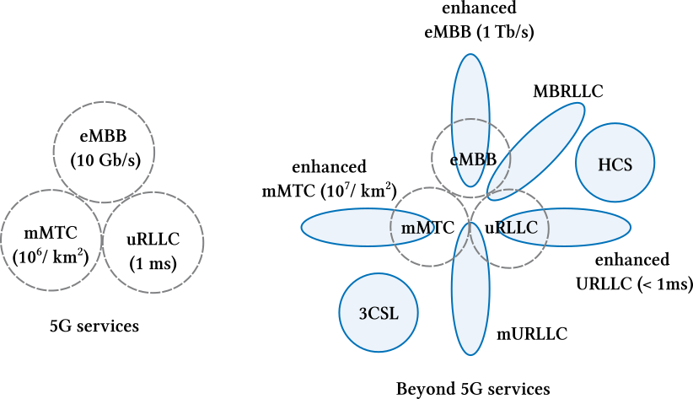
5G and Beyond Networks
Three main service types in 5G include Enhanced Mobile Broadband (eMBB), Ultra Reliable Low Latency Communications (URLLC), Massive Internet of Things (mMTC).
Additional service types in beyond 5G (B5G)
  Envisioned services impose stricter QoS requirements on existing categories.
  Applications such as XR require fusion of existing 5G services.
  New services such as human-centric-services (HCS) and converged compute, communication, control, and sensing (3CSL).
Notes:
The 5th Generation (5G) mobile networks are poised to support a wide range of services that go well beyond traditional voice and data.
5G services are mainly classified into 3 types.
eMBB with peak data dates above 10 Gbps, uRLLC with a target of 1ms latency, and mMTC with a target of mMTC 1 million connections per square km.
Services envisioned for 5G and beyond mobile networks impose even stricter requirements – applications such as connected vehicles require <1ms latency and seven-nines reliability which are not met by 5G. Emerging applications such as extended reality require a fusion of 5G services – eMBB + uRLLC = MBRLLC.
B5G is also expected to support new types of services
HCS – brain computer interaction
3CSL – autonomous closed loop control of industrial processes
Supporting multi-faceted requirements of 5G and beyond mobile networks warrant a highly flexible network architecture, which we talk about in the upcoming slides.

Slide 3
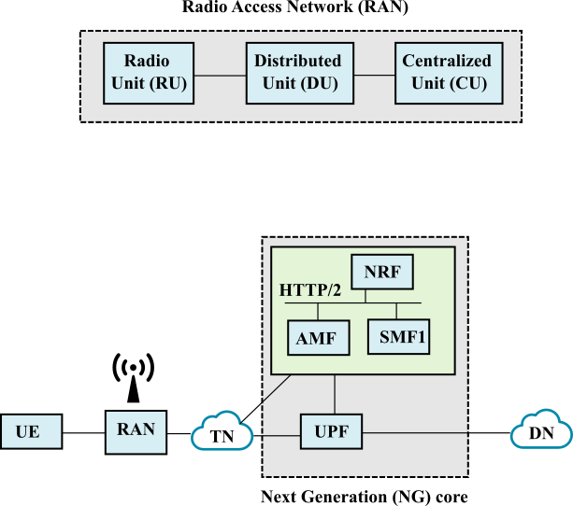
5G and Beyond Networks - Architecture
Flexible RAN architecture consisting of RU, DU and CU.
Next Generation (NG) core separates the current Evolved Packet Core (EPC) functions into finer grained Network Functions.
Network functionality is decoupled from the hardware in the form of virtual network functions (VNFs).
Adoption of cloud-native principles.
Notes:
To provide the necessary flexible to support the various service types, network architecture for 5G and beyond has several changes compared to existing LTE networks.
Traditional RAN functionality is decoupled into Remote Radio Unit (RRU), Distributed Unit (DU), and Central Unit (CU). Different RAN functions (e.g., Radio Resource Control (RRC), Radio Link Control (RLC), Medium Access Control (MAC), and Baseband Unit (BBU)) can be disaggregated and hosted on RRU/DU/CU to support a highly flexible functional split that is tailored to support specific use-cases.
Both RAN and core NFs can be deployed as VNFs on commodity servers using virtual machines (VMs), containers, or unikernels. Virtualizing RAN and core NFs enable flexibility in creating, operating, and managing NFs by hosting them on distributed computing facilities, including multi-access edge computing (MEC) data centers
The architecture also adopts the cloud native principles where each network function can be individually deployed, scaled and upgraded.

Slide 4
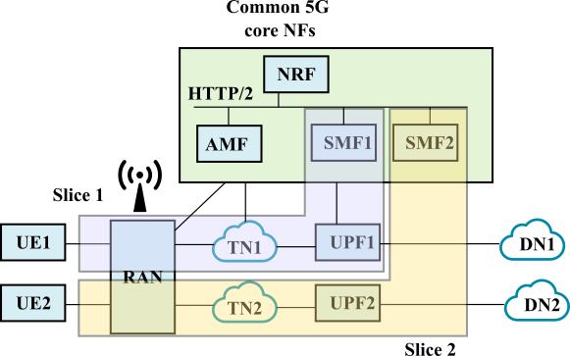
5G and Beyond Networks – Network Slicing
Isolated logical networks, customized for each application or service, by chaining together different VNFs.
Allows multiple virtual networks to be created on top of a common shared physical infrastructure.
Consists of different subnets, such as example: Radio Access Network (RAN) subnet, Core Network (CN) subnet, Transport network subnet.
Notes:
Network slicing, facilitated by network softwarization and virtualization, is a key enabling technology to accommodate different QoS requirements on the same physical infrastructure.
Network slicing enables the creation of isolated logical networks by chaining together different VNFs, where each slice can be tailored to meet the requirements of a particular service type such as eMBB or URLLC.
It enables on-demand deployment of right-size virtualized network functions (VNFs) at the appropriate location, to meet the stringent requirements imposed by the 5G and beyond services.
The figure shows the concept of network slicing, where we have two slices – slice 1 (shown in blue) and slice 2 (shown in yellow). Each slice has some VNFs that are common, e.g. the AMF, while NFs which can affect the performance the most such as the UPF are present as dedicated instances for each slice.
It is important to note that an E2E network slice can span different segments of the network such as the radio access network, the transport network, as well as the core network.

Slide 5
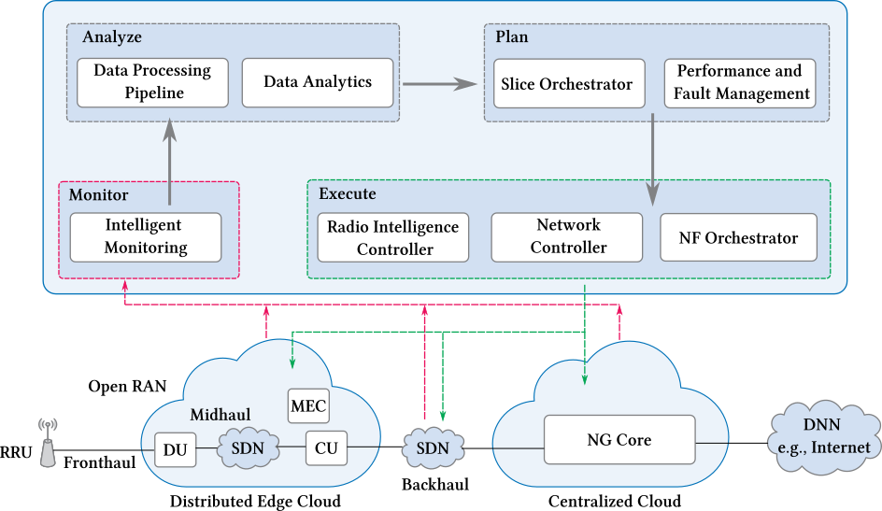
Closed Loop Automation (CLA) in 5G and Beyond
E2E slice management and orchestration is challenging
  Softwarization and virtualization broaden the surface for faults.
  Faults and performance degradation can unfold at various levels.
Necessitates a data driven approach
  Automated, intelligent agents capable of making management decisions on behalf of the network operators are used to manage the network infrastructure.
  AI/ML based predictive maintenance can reduce downtime and maintenance costs.
Notes:
An E2E network slice extends the virtual network into multiple technological and administrative network segments (e.g., RAN, transport network, edge cloud, and NG core), as shown in the Figure.
Managing such E2E network slices involving heterogeneous resources manually can be cumbersome and time-consuming. Softwarization and virtualization increases the surface for faults where faults can occur at various levels such as the infrastructure, hypervisor, as well as virtualized network functions, which can lead to QoS violations.
This necessitates data-driven orchestration and management approaches to support the QoS guarantees expected from 5G and beyond networks, which cannot be satisfied with traditional reactive human-in-the-loop orchestration and management approaches.
This figure shows our vision for closed-loop orchestration and management of 5G and beyond mobile networks. We extend the monitor-analyze-plan-and-execute (MAPE) control loop to present our view of CLA in 5G and beyond mobile networks. Each component of CLA in the figure, such as the network controller can adopt AI/ML techniques to provide intelligent, data-driven, and automated orchestration and management. This can provide efficiency in network operations and management and reduce downtime and maintenance costs.
In the subsequent slides, we present the different components of the MAPE loop, and discuss the crucial role of AI/ML in its every aspect.

Slide 7
Intelligent Monitoring
Intelligent algorithms for network orchestration form the foundations for closed-loop automation.
Algorithms are data-driven; Require large amounts of data for conducting predictive analysis and training AI models.
Monitoring must be done subject to the constraints imposed by the capacity of the network. Must employ intelligent monitoring to collect only those metrics that are necessary to the orchestration algorithms.
Notes:
Realizing closed loop automation implies that the network has the ability to make orchestration decisions in light of prevailing network conditions
Modern algorithms for automated decision making tend to rely on data-driven methods meaning that the ability of operators to realize CLA is dependant on their ability to extract large volumes of data from the network efficiently.
Need orchestration for the end-to-end network, so we need to collect metrics from the RAN, the core and the transport segemnts (fronthaul, midhaul, backhaul)
Need to take into account the constraints on monitoring that are imposed by the capacity of the network. Therefore intelligent algorithms are required such that only those metrics that are required to improve the performance of the orchestration algorithms are collected.

Slide 9
Data Processing and Data Analytics
Responsible for ingestion, cleaning, indexing, enrichment and storage of data, most of which is collected by the intelligent monitoring component.
Pipeline will leverage distributed cluster platforms such as Hadoop and Apache Spark to ensure that the processing can scale with the size of the CLA platform.
Examples of inferences that the analytics component will make include forecasting traffic volumes, predicting congestion events and predicting user mobility.
Notes:
Ingests, cleans, inexes, enriches and stores data, most of which is collected by the intelligent monitoring component.
The pipeline and analytics components will need to leverage distributed cluster platforms such as Hadoop and Apache Spark
The data analytics module is a crucial component of the CLA platfomr given that AI/ML techniques will be the primary method to extract knowledge from the processed data.
Examples of inferences that the analytics component will make include forecasting traffic volumes, predicting congestion events and predicting user mobility.

Slide 11
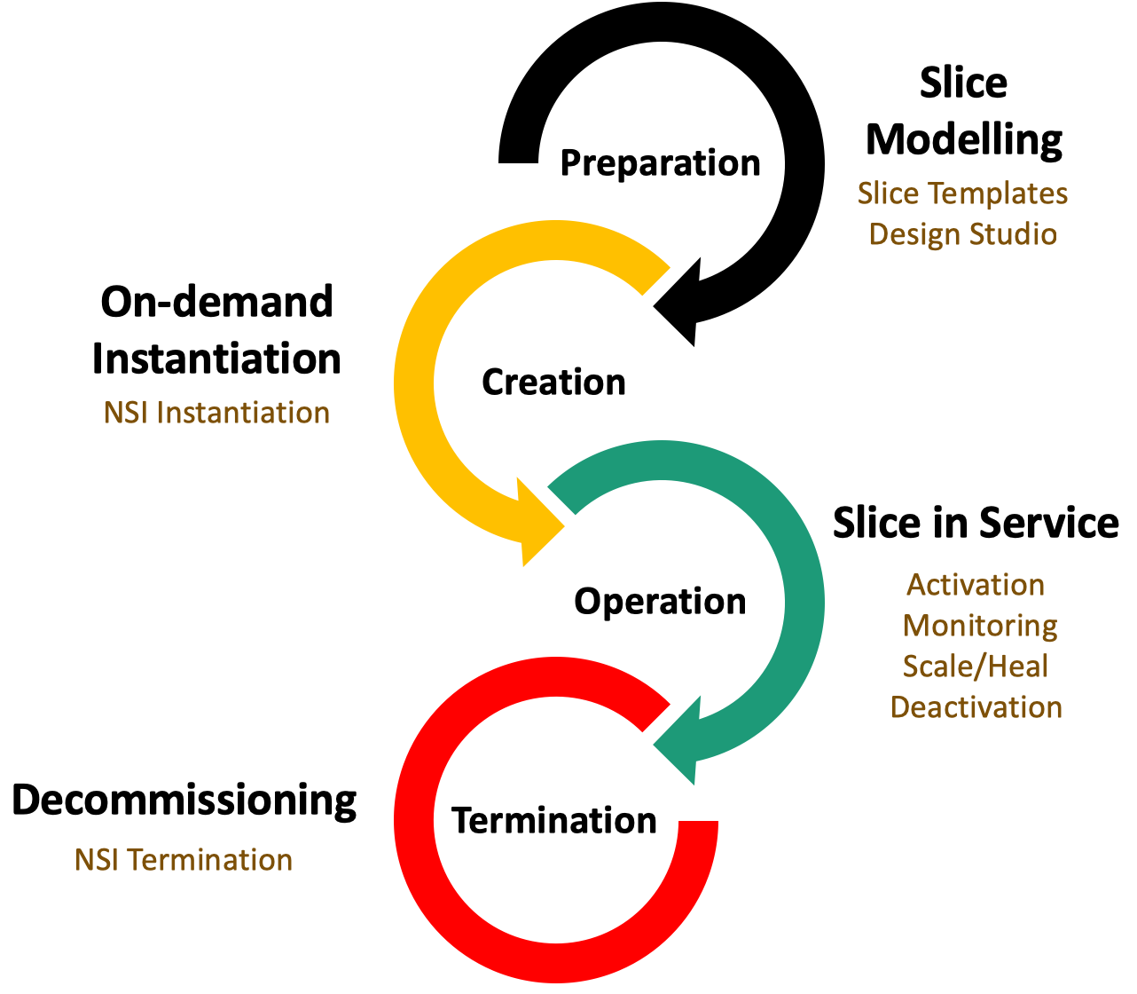
Slice Orchestrator
Interacts with the NF Orchestrator to provision resources in the NFVI upon slice instantiation.
Responsible for the runtime management of the slices including scaling, migration and healing.
Decommissions slices upon termination, reclaiming the resources to be used by subsequent slices.
Notes:
Provides an NBI to operators for deploying slices into the underlying infrastructure.
Responsible for translating high-level, goal-oriented network plans into resource allocation decisions.
RA decisions passed on the the network function orchestrator.
Also responsible for carrying out run-time management of the slices as they are specified in the network plan. Run time operations include slice scaling, network function migration and automated fault management.
The slice orchestrator also decomissions slices upon request from the slice owner or network operator.

Slide 12
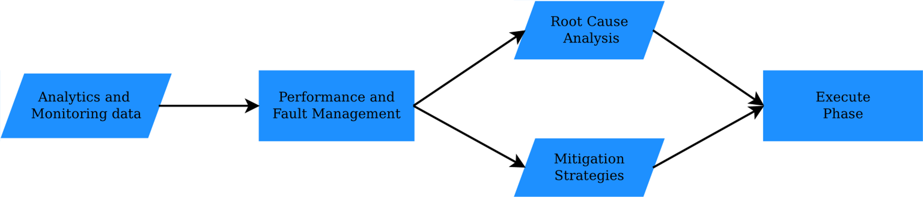
Performance and Fault Management
Failures and faults are an inevitable part of complex distributed systems.
Realizing CLA requires mechanisms to mitigate the impact of faults and failures, especially those that impact QoS for end-users.
Performance and fault management relies on the data analytics component to gain insight as to the root cause, effect and possible mitigation workflows for faults.
Notes:
* Given that failures and faults are an inevitable part of complex distributed systems, the realization of CLA requires mechanism sto mitigate the impact of faults and failures, particularly those that impact that QoE for end users.
* The performance and fault management module will rely on the data analytics component discussed in a previous slide to gain insight as to the root cause, effects and possible mitigation workflows for faults.

Slide 14
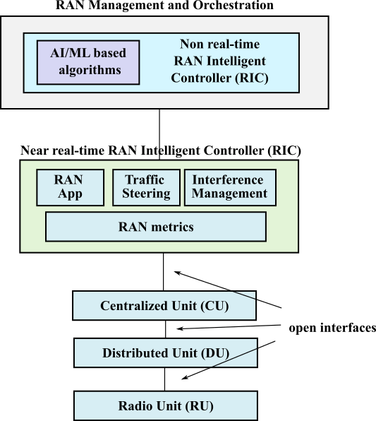
Radio Intelligence Controller
Radio intelligence controller (RIC) is used for orchestration and management in the RAN.
Two main control loops
  Near real-time RIC: Performs Radio Resource Management (RRM) tasks. AI algorithms for tasks such as UE-centric QoS management.
  Non real-time RIC: Responsible for policy and configuration that influences the behavior of the RAN.
Notes:
Legacy RAN solutions make use of closed-box functions and proprietary interfaces, which makes it difficult to flexibly control radio resources and impedes the realization of E2E slicing.
Due to this, our vision of closed loop automation in 5G and beyond leverages the Open RAN paradigm, and leverages open interfaces between the CU, DU and RU and the Radio Intelligence Controller.
The Radio intelligence controller provides the flexibility to leverage RAN metrics collected by the monitoring to deploy AI/ML based models for intelligent management and orchestration of the RAN.
There are two main control loops in the radio intelligence controller.
A near real-time loop that operates in timescales of 10ms to 1 sec. The near real-time RIC is co-located with the CU and performs many of the Radio Resource Management (RRM) tasks that are carried out by traditional eNBs and gNBs. The near real time RIC leverages embedded AI algorithms to carry out more nuanced tasks, such as UE-centric QoS management
A non real-time loop that operates in timescales of greater than 1 sec.
The non real-time RIC interacts with the near real-time RIC to apply policy and configuration that influences the behavior of the RAN. Policy and configuration could include new applications developed in-house by Telecom operators or by third-parties. It is also envisioned that the non realtime RIC will host RAN analytics and model training, with the trained models and analytic insights deployed to the near real-time RIC to realize the policy defined by the network tenants.
Overall the Radio Intelligence Controller is a crucial component to realize a flexible, softwarized RAN that provides the interfaces necessary to create on-demand E2E network slices

Slide 15
NF Orchestrator and Network Controller
The NF Orchestrator is the counterpart to the VIM in the ETSI NFV infrastructure.
NF Orchestrator is responsible for managing the physical resources that constitute the NFVI. This includes compute resources, storage resources and network resources.
NF Orchestrator provisions resources on command from the slice orchestrator.
In contrast the network controller is responsible for provisioning end-to-end paths in the transport segments to interconnect the NFs that constitute a slice.
Network controller incorporates state-of-the-art techniques for routing optimization and virtual network embedding to ensure that the QoS constraints of the slices are satisfied.
Notes:
The NF orchestrator is the counterpart to the VIM in the ETSI NFV infrastructure
Primary responsibility of the NF Orchestrator is the management of the NFV infrastructure. This includes the compute, storage and networking resources that constitute the NFVI.
Provisions resources on request from the slice orchestrator, providing a NBI for resource allocation and management.

Slide 16
Research Directions
Slice requirements translation
  Need to map the high-level slice QoS requirements to infrastructure resource requirements.
  Affected by factors such as network condition, isolation between slices, and traffic load.
Dynamic function splitting in the RAN
  Open interfaces allow different functional splits for different slices, allowing the network to be tailored to support specific use-cases.
  Appropriate functional splits need to be selected keeping in mind the limitations of transport delay budget and bandwidth.
Data-driven orchestration algorithms
  Contemporary strategies are oblivious to the future network conditions and changes in traffic volume.
  Orchestration decisions need to be adapted every so often by leveraging data-driven predictive models and QoS requirements of slices.
Notes:
Map the high-level slice QoS requirements into appropriate infrastructure resource requirements, including RAN and core NF requirements. Representing resource needs as a function of slice QoS requirements is non-trivial, since their relationship is not linear and various factors such as network condition, the level of isolation between slices, and traffic load influence the perceived QoS for end users.
RAN disaggregation and the softwarization of the RAN NFs opens the possibility of employing different functional splits in the RAN. Open-interfaces and embedded intelligence can enable AI/ML-driven dynamic function splitting, where RAN NFs are split between the CU and DU depending on the traffic type. This enables different functional splits for different slices, allowing the network to be tailored to support specific use-cases. Orchestrating disaggregated NFs is challenging considering the need for highly flexible traffic steering solutions in the midhaul and backhaul segments. In this context, a better understanding of the appropriate functional splits for various slices is needed, which is adapted to the requirements of different use-cases and the limitations of transport delay budget and bandwidth.
Contemporary slice orchestration solutions usually over-provision resources to circumvent worst-case network behaviors or to accommodate peak traffic demand. Such over-provisioning results in inefficient use of resources and blocking of future network slices. A possible solution to this is to adapt orchestration decision from time-to-time by taking advantage of data-driven predictive models and the QoS requirements of the slices.

Slide 17
Research Directions (cont.)
KPI and infrastructure monitoring
  Computing KPIs for E2E network slices is challenging; analysis of the relation between infrastructure and NF KPIs and slice KPIs is needed.
  Push-based streaming telemetry can be a viable alternative to traditional polling-based approaches in order to meet the requirements of mission-critical 5G services.
Predictive maintenance
  Prediction models for network equipment failures can give early notification of failure or degradation events and help in taking preventive measures.
Fault and performance management
  Root cause analysis is crucial to isolate alarms and extract meaningful dependencies between them, leading to subsequent stages of mitigation and healing.
  Reinforcement Learning is a promising approach for enabling networks to learn the best mitigation workflow.
Notes:
A key challenge in KPI monitoring is the non-trivial difficulty in computing these KPIs for E2E network slices. Many of these KPIs are composite, i.e., require measuring multiple infrastructure and NF related metrics for computing their values. A detailed understanding of how different infrastructure and NF related metrics impact the network slice KPIs is needed. Traditional polling-based approaches work at coarse time granularity that may be inadequate for providing service assurance to mission critical URLLC services. More recently, push-based streaming telemetry is gaining traction in both academia and industry because of its capability to stream network telemetry data directly from the devices to the collection and analysis engines in near realtime. However, push-based telemetry comes with a tradeoff among overhead and accuracy which must be thoroughly investigated.
Predictive maintenance of network equipment is an alternate to scheduled or periodic maintenance, which can minimize downtime and maintenance costs. Prediction models for network equipment failures give early notification of events (e.g., link/device failure) that may lead to performance degradation (e.g., QoS violations) and help in taking preventive measures (e.g., reroute traffic, migrate NFs)
A key challenge in this aspect is the collection and labeling of network operational data. In operational networks, device logs are typically collected without any labels and often miss failure data. Consequently, it becomes difficult to associate failures and alerts from network equipment to their physical meaning.
Identification of faults and performance degradation is crucial to ensure the QoS requirements for E2E slices in 5G and beyond mobile networks. Once a fault or a performance degradation has been identified, it is quintessential to localize its root cause, by isolating alarms and extract meaningful dependencies between them, which leads to subsequent stages of mitigation and healing. With the complexity of 5G and beyond networks, it is impractical to hand-craft if-this-then-that policies for triggering mitigation workflow in the face of failures. In this context, Reinforcement Learning is a promising approach for enabling networks to learn the best mitigation workflow for different scenarios over time.

Slide 18
Questions

Slide 19
Research Challenges
Slice Requirements translation
  Need to map high-level resource requirments of tenants into lower level decisions about resource allocation.
  Problem: Impact of resource allocation decisions is not the same for every service. Need to understand how infrastructure level decisions impact perceived QoS for service users.
Dynamic Function Splitting in the RAN
  RAN disaggregation and the softwarization of the RAN NFs opens the possibility of employing different functional splits for different slices.
  Problem: The use of different functional splits increases the complexity of orchestration. Need the ability to steer traffic for different slices to the correct set of RAN NFs as well as the ability to deploy RAN NFs in either the CU or the DU depending on the split being used.

Slide 20
Research Challenges (Cont.)
Data Driven Orchestration Algorithms
  In order to close the network orchestration and slice management loop, algorithms that can make intelligent resource allocation decisions are required.
  Problem: Contemporary RA algorithms are oblivious to future network conditions, trends and fluctuations in traffic volume. Take advantage of data-driven predictive models to ensure that the QoS requirements of the slices are satisfied.
KPI and Infrastructure Monitoring
  To facilitate orchestration algorithms, the CLA platform needs to quantify the QoS experienced by slice users.
  Problem: QoS cannot be easily quantified using traditional metrics like latency, bandwidth or jitter. As such a CLA platform will likely require composite KPIs that are computed as a function of many different sub-metrics.

Slide 21
Research Challenges (Cont.)
Fault and Performance Management
  Faults in hardware and software components that implement the CLA platform are inevitable.
  Problem: Identifying the root-cause of a fault and determining a mitigation workflow seems to require human intervention.
  Investigate reinforcement learning to remove the humans in the loop for fault and performance management.

